Slide 1
Face Segmentation Florian Bettini – Maxime Lutel – Gabriel Muller – Benjamin Pommier

Slide 2
TABLE OF CONTENTS
The topic. What are we doing ? > Objective & Datasets & Related work --- Floby
Why is it interesting ? Problematic & applications --- Gab’
Presentation of the Pipeline --- Pom’
Zoom différents éléments: experiments & results
Face detection --- Gab’
Features extraction : probability maps --- Pom’
Features extraction : other features (edge, pooling, segmentation, threshold) --- Lulu
Face segmentation : results & experiments > nombre et type de features, # d’observations, photos differentes (autres datasets) --- Lulu
Gender & Head Pose --- Floby
Conclusion & Next Steps --- Pom’

Slide 3
TABLE OF CONTENTS
Face segmentation – Presentation of the Project
A
Applications
B
The Pipeline
C
Experiments & results
D
Conclusion & next steps
E

Slide 4
REPORT
Abstract --- (later)
Introduction & Motivation (use PP) --- Gab’
Problem definition (use slide 1. & 2.) --- Floby
Related work (use PP) --- Gab’ & Floby
Methodology > Presentation of the Pipeline --- Pom’
Experiments & results
Face detection --- Gab’
Features extraction : probability maps --- Pom’
Features extraction : other features (edge, pooling, segmentation, threshold) --- Lulu
Face segmentation : results & experiments > nombre et type de features, # d’observations, photos differentes (autres datasets) --- Lulu
Gender & Head Pose --- Floby
Conclusion & Next Steps ---

Slide 5
THE PIPELINE
What did we use ?

Slide 6
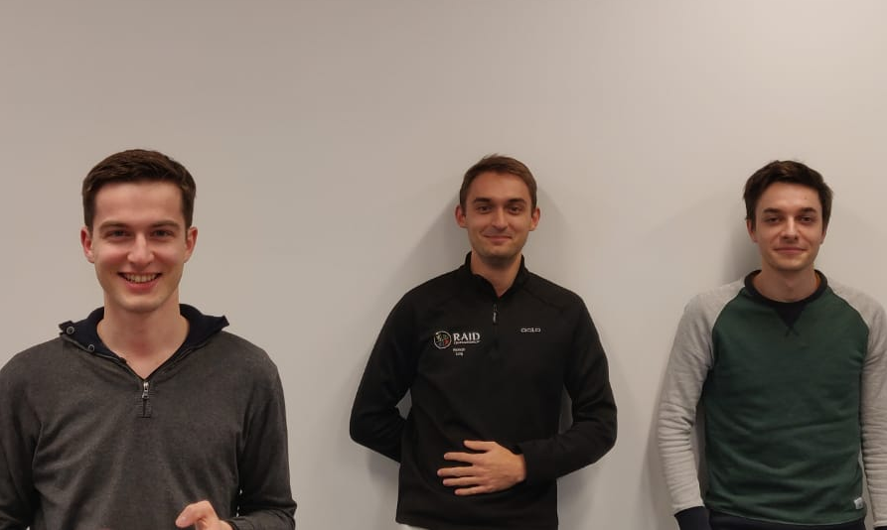
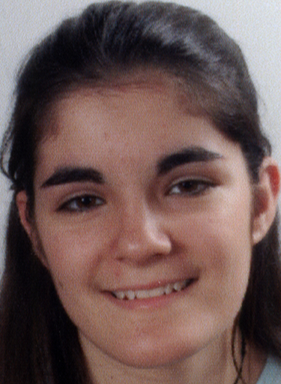
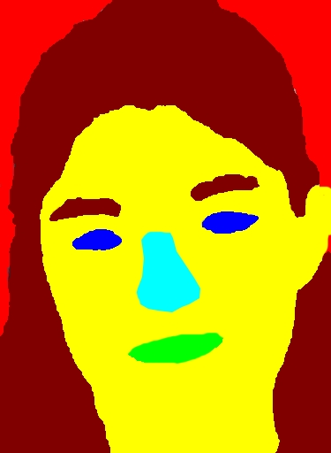
PIPELINE USED TO GENERATE THE USE CASES
1
2
3
4a
4b
Gender detection
4a
Capitalizing on the extracted face segmented to detect the gender
Face
dectection
1
Features extraction
2
Face
segmentation
3
Isolation of the faces in an image
Haar Cascade
Probability maps extracted with:
HoG
Pixel location
HSV histograms
RandomForest
Xxxx ?
Training & testing of a supervised model to classifify each part of the face
Head Pose Estimation
4b
Determination of the gaze direction

Slide 7
EXPERIMENTS & RESULTS
What is the output ?

Slide 8
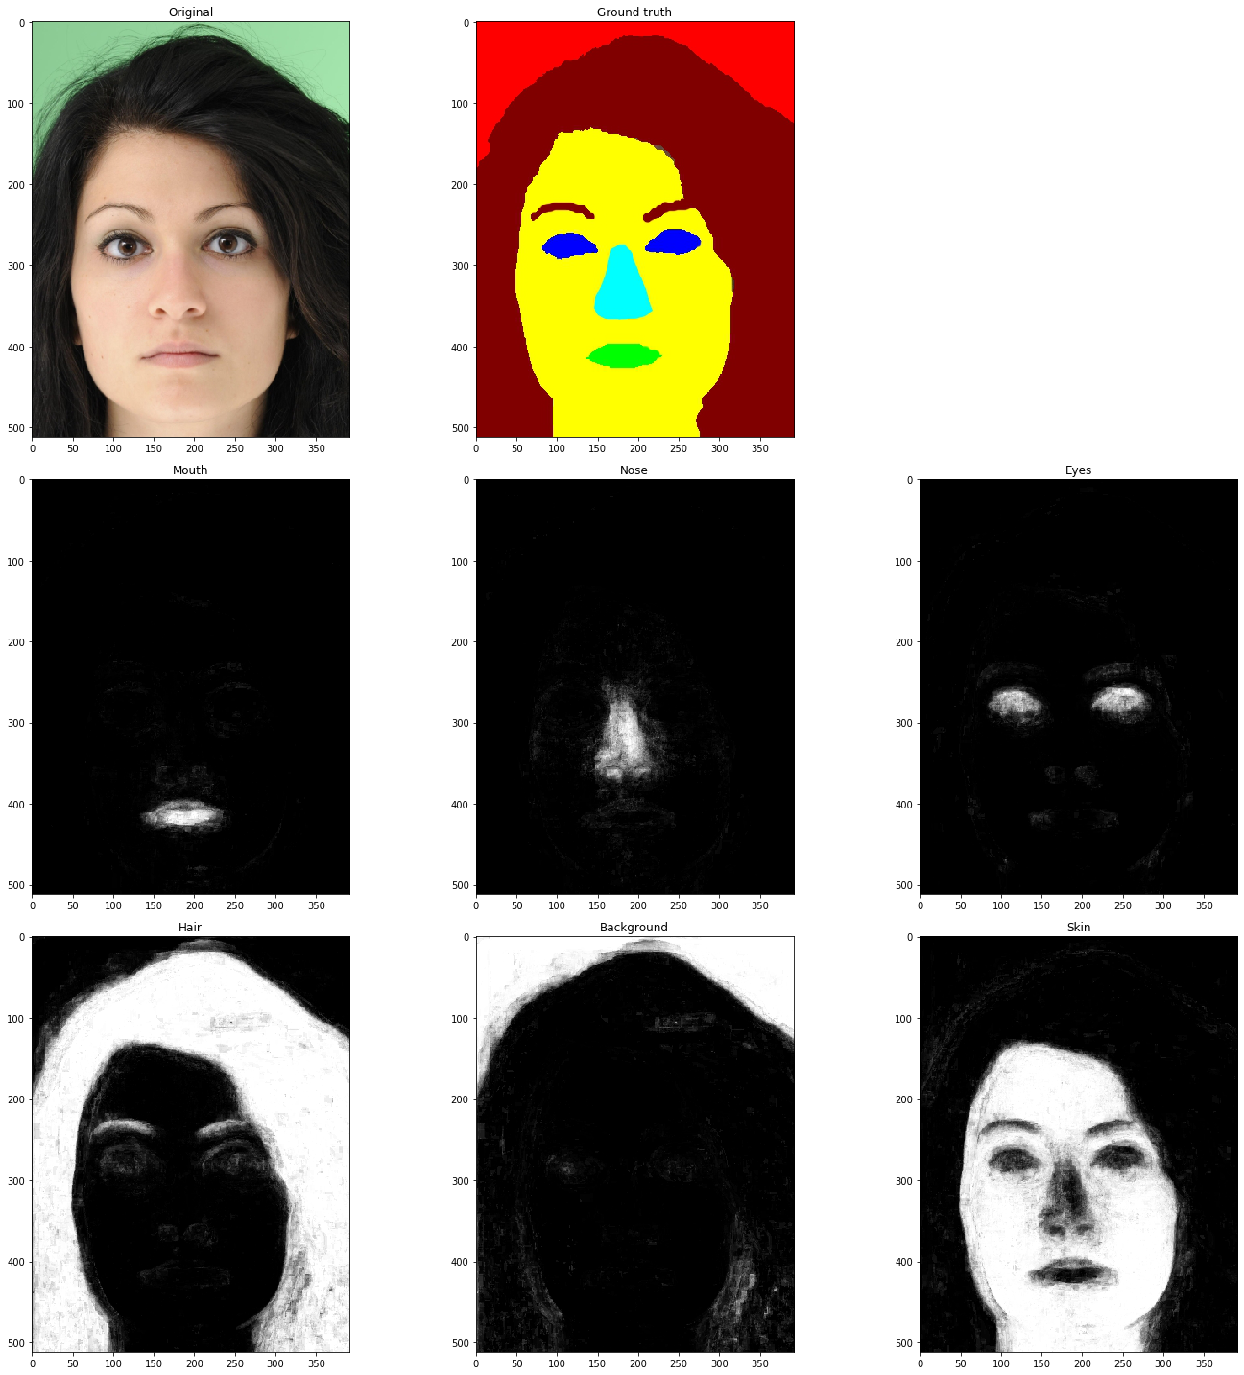
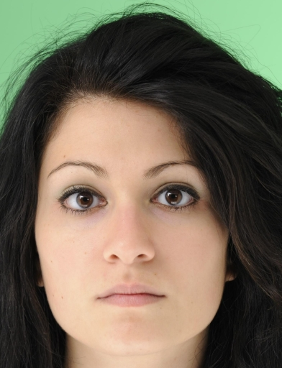
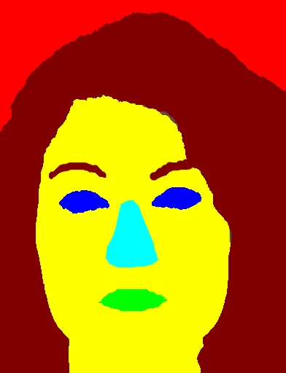
PROBABILITY MAPS EXTRACTION FROM LABELED DATA
1
2
3
4a
4b
Features used
Precision (train | test set)
HoG descriptors
Block of 16x16 computed on 8x8 cells
Value attributed to the center pixel
9 orientations bins
HSV Histograms
Block of 16x16 analysed
16 bins for each histogram
Spatial
Relative location for x and y coordinates on the image
Mouth
RF⁽²⁾: 97% | 80%
LR⁽³⁾: 36% | N.A.
Hair
RF: 98% | 91%
LR: 84% | 77%
Nose
RF: 99% | 84%
LR: N.A.
Background
RF: 98% | 97%
LR: 85% | 93%
&
Eyes
RF: 98% | 92%
LR: N.A.
Skin
RF: 95% | 86%
LR: 82% | 80%
Note: (1) Overall accuracy train vs. Test (RF: 97% | 89% & LR: 83% | 79%)
(2) RF: RandomForest (n_estimators: 50, min_samples_leaf: 100)
(3) LogisticRegression (C=0.1)

Slide 9
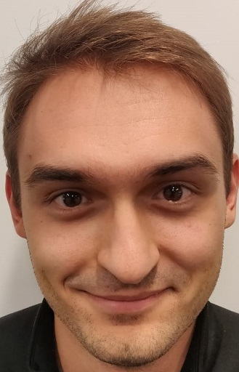
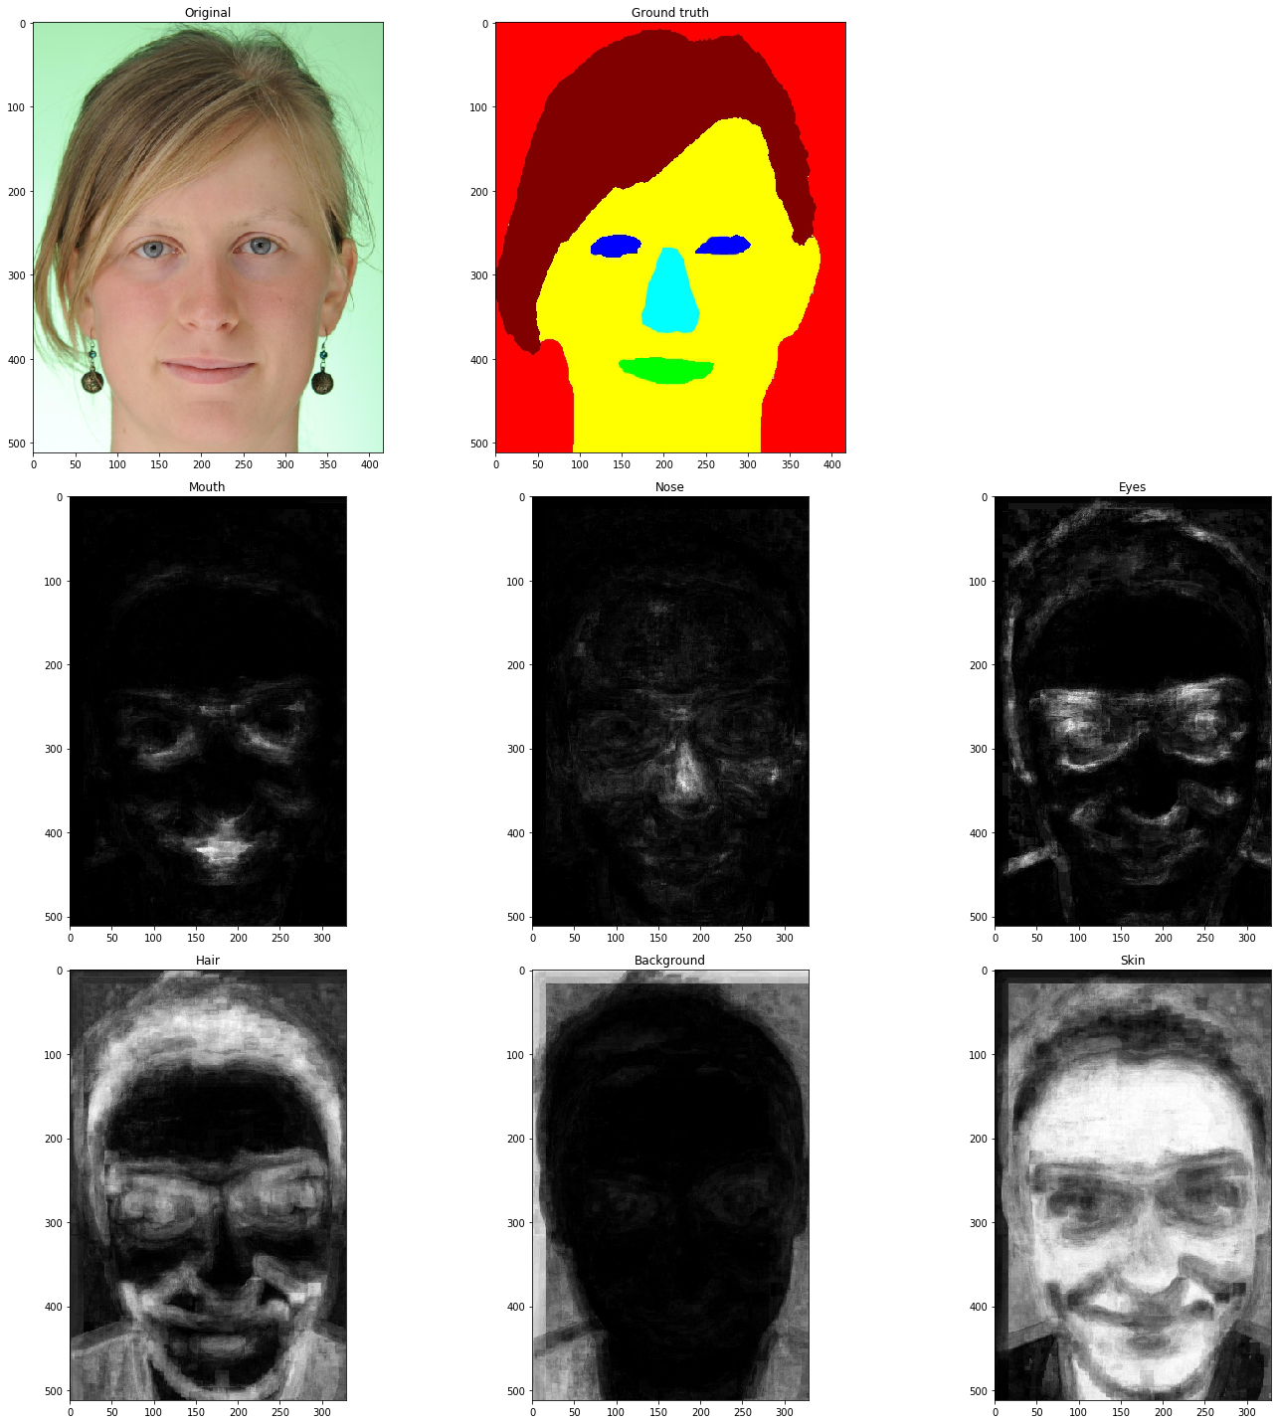
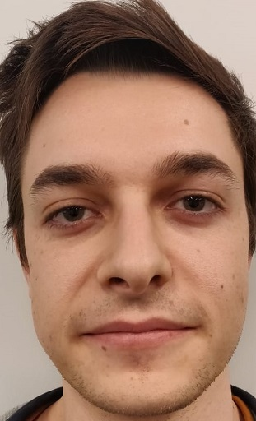
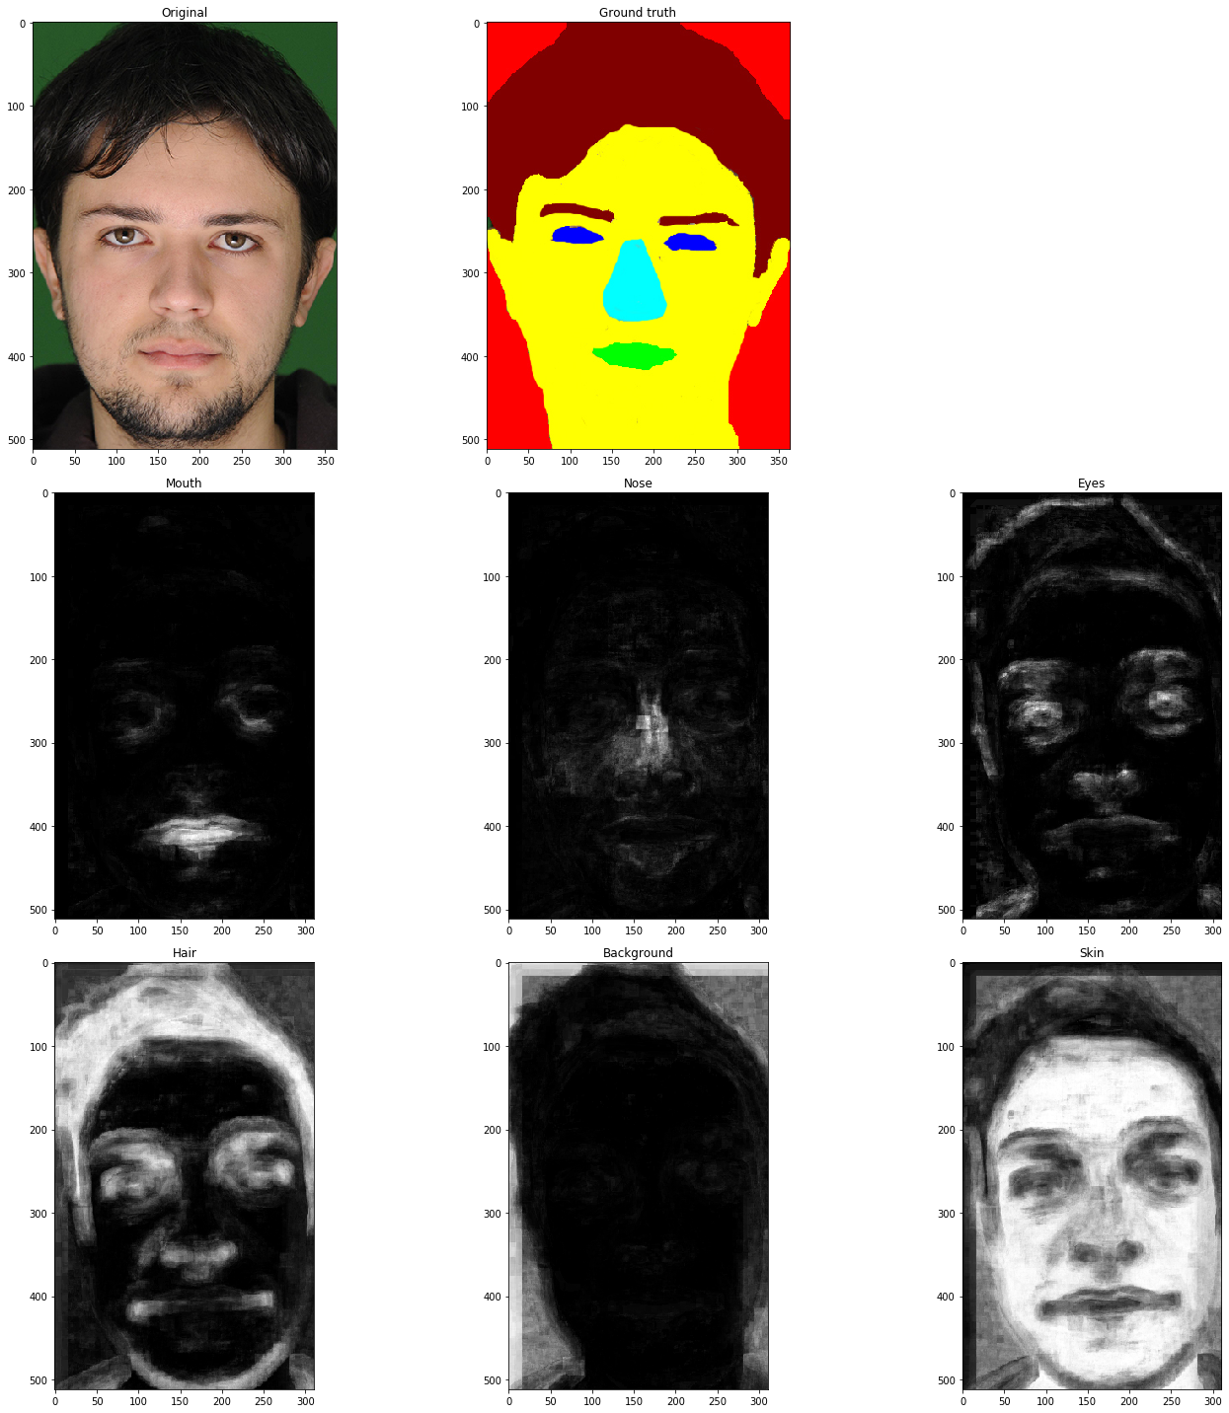
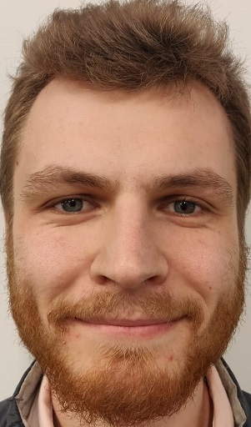
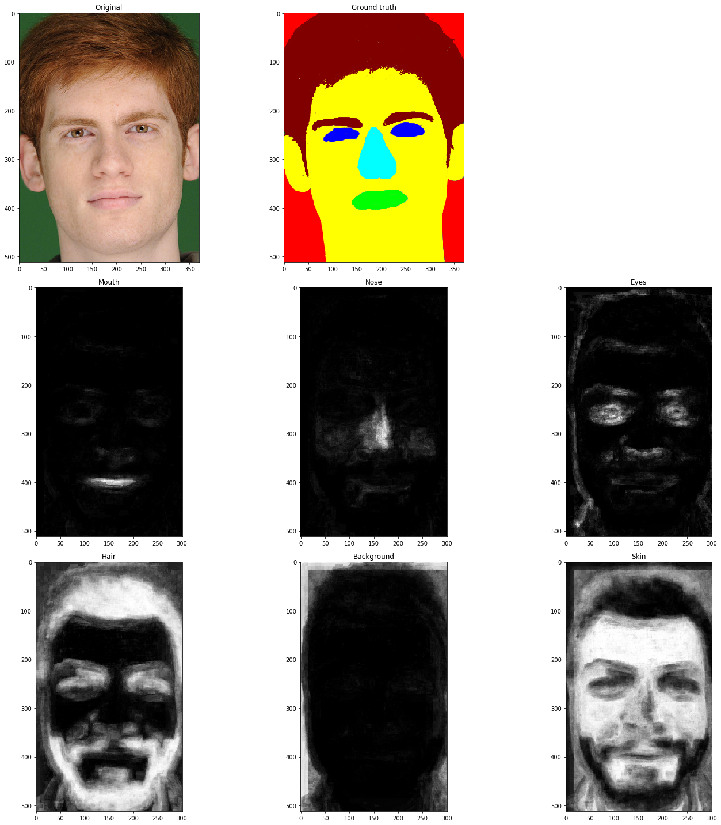
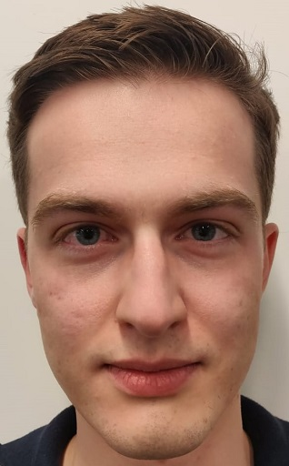
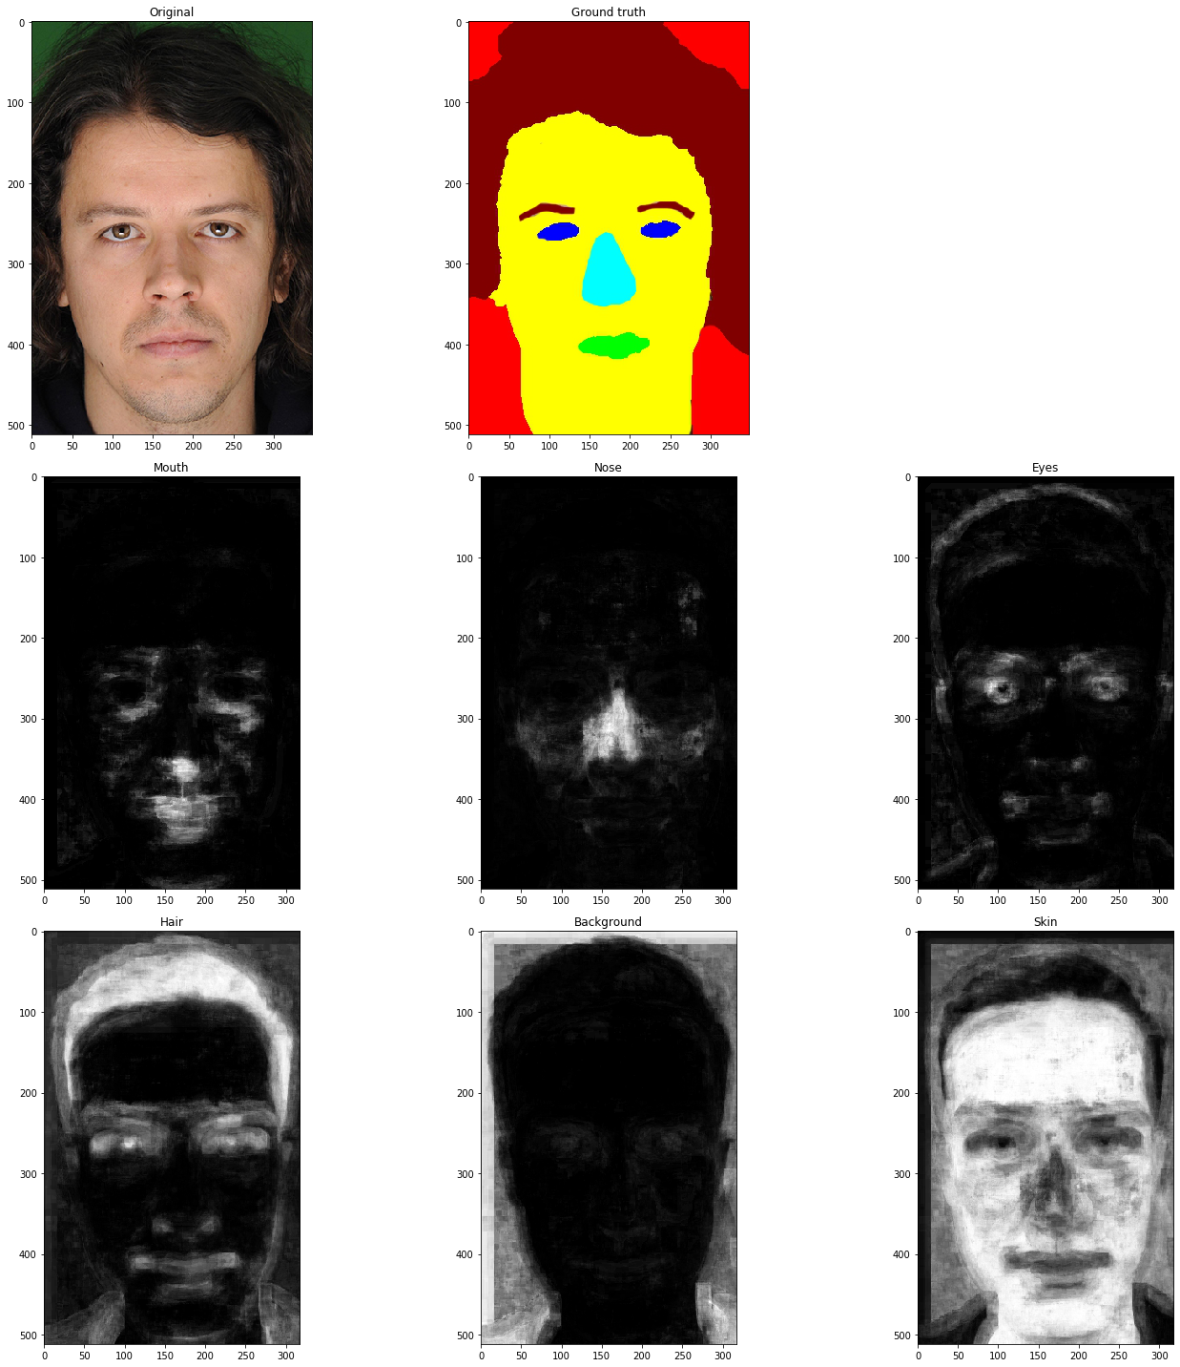
APPENDIX – PROBABILITY MAPS ROBUSTNESS WITH OTHER DATA
A
B
C
D

Slide 10
APPENDIX – PROBABILITY MAPS FEATURES SELECTION PROCESS
Features combination | Macro Acc. (Train) | Macro Acc. (Test) | Weighted Acc. (Train) | Weighted Acc. (Test)
Spatial + HoG | 73% | 55% | 90% | 78%
Spatial + HSV | 90% | 63% | 96% | 87%
HoG + HSV | 79% | 60% | 93% | 84%
HoG | 47% | 28% | 71% | 46%
HSV | 75% | 54% | 92% | 82%
Spatial + HSV + HoG | 89% | 70% | 96% | 88%
Note: Using a RandomForestClassifier
(n_estimators: 10, min_samples_leaf: 100)

Slide 11
BIG CONCEPT
Bring the attention of your audience over a key concept using icons or illustrations

Slide 12
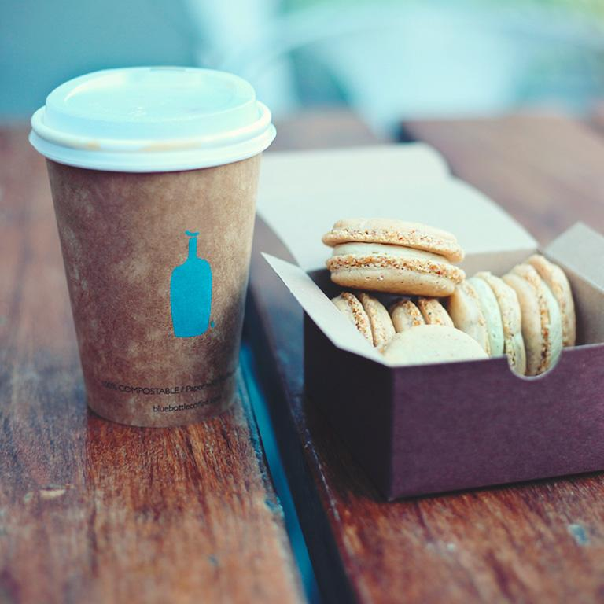
A PICTURE IS WORTH A THOUSAND WORDS
A complex idea can be conveyed with just a single still image, namely making it possible to absorb large amounts of data quickly.

Slide 13

WANT BIG IMPACT?
Use big image

Slide 14
SlidesCarnival icons are editable shapes. This means that you can:
Resize them without losing quality.
Change fill color and opacity.
Change line color, width and style.
Isn’t that nice? :) Examples:

Slide 15
Now you can use any emoji as an icon!
And of course it resizes without losing quality and you can change the color.
How? Follow Google instructions https://twitter.com/googledocs/status/730087240156643328
😉
✋👆👉👍👤👦👧👨👩👪💃🏃💑❤😂😉😋😒😭👶😸🐟🍒🍔💣📌📖🔨🎃🎈🎨🏈🏰🌏🔌🔑 and many more...

